Slide 1
EndNote 2025 is here: discover the game-changing features you can't miss!

Slide 2
Session objectives
By the end of this session, you will:
Get a first look at brand-new interface and tools in EndNote 2025
Learn how the latest updates will save you time and reduce errors
See live demos of enhanced integrations and automation features
Have the opportunity to ask questions directly to the EndNote team

Slide 3
What’s new in EndNote 2025?
Key Takeaway
Find a Journal in Cite While You Write
Cite from a PDF
Summary Panel Redesign
Web of Science Citing Articles
Enhanced Sync process visibility
Option to use en dashes for Pages and Date Ranges
Library details in the Library Status window
Updates to the Edit tab

Slide 4
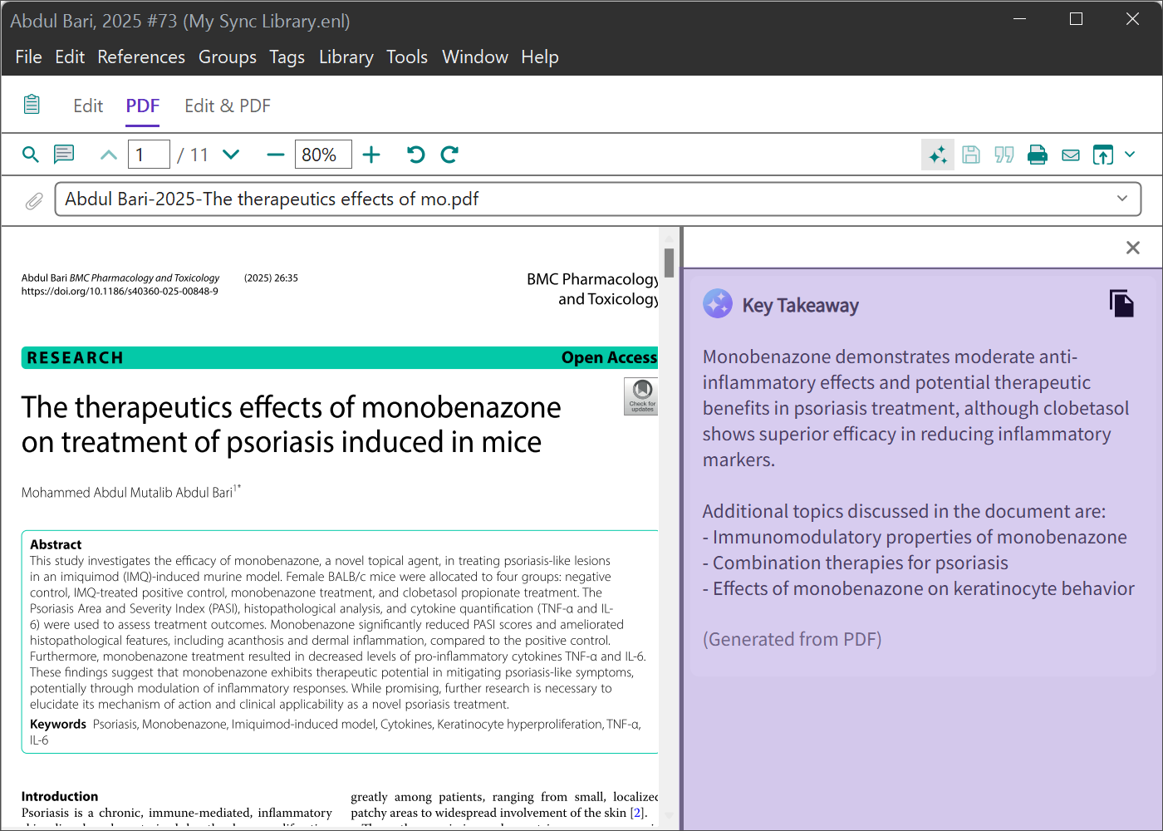
AI-Powered Research Assistant
Advanced grouping and record updating
AI-Powered Paper Summaries
Auto-generates concise summaries
Speeds up literature review
Available directly in Summary Panel

Slide 5
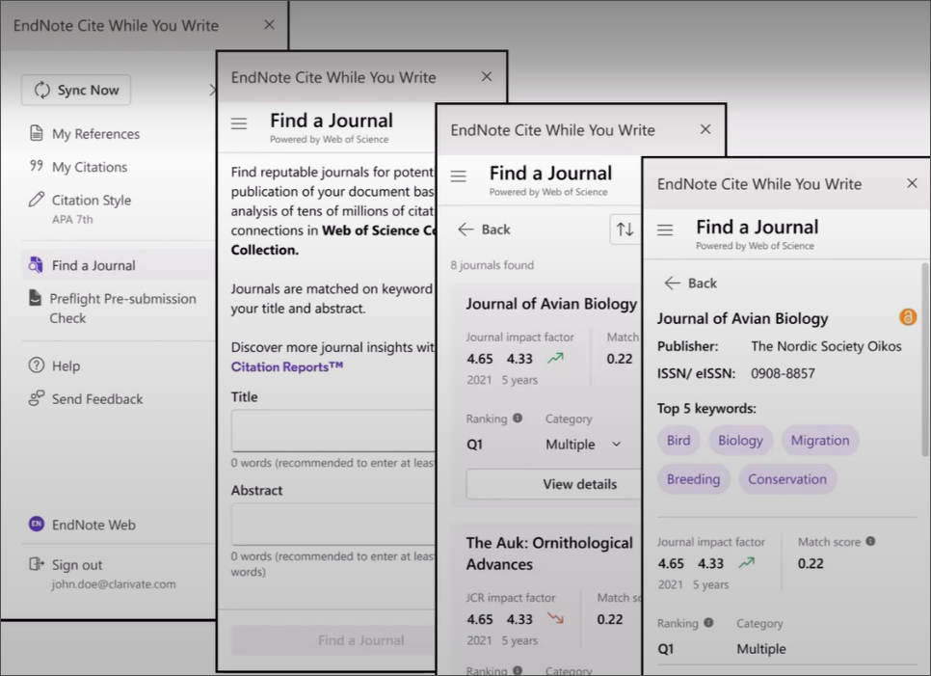
Find a Journal
Advanced grouping and record updating
Built-In Journal Suggestions
Currently available in Microsoft Word Online
Uses manuscript content to suggest journals
Replaces the separate Manuscript Matcher tool

Slide 6
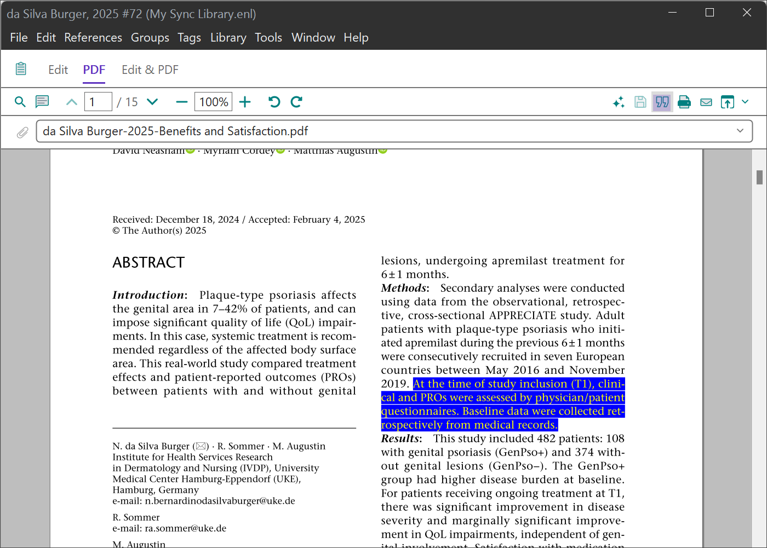
Cite from a PDF
Advanced grouping and record updating
Quote & Cite from Any PDF
Highlight text in an attached PDF
Right-click to insert quote + citation
Saves annotations directly to the record

Slide 7
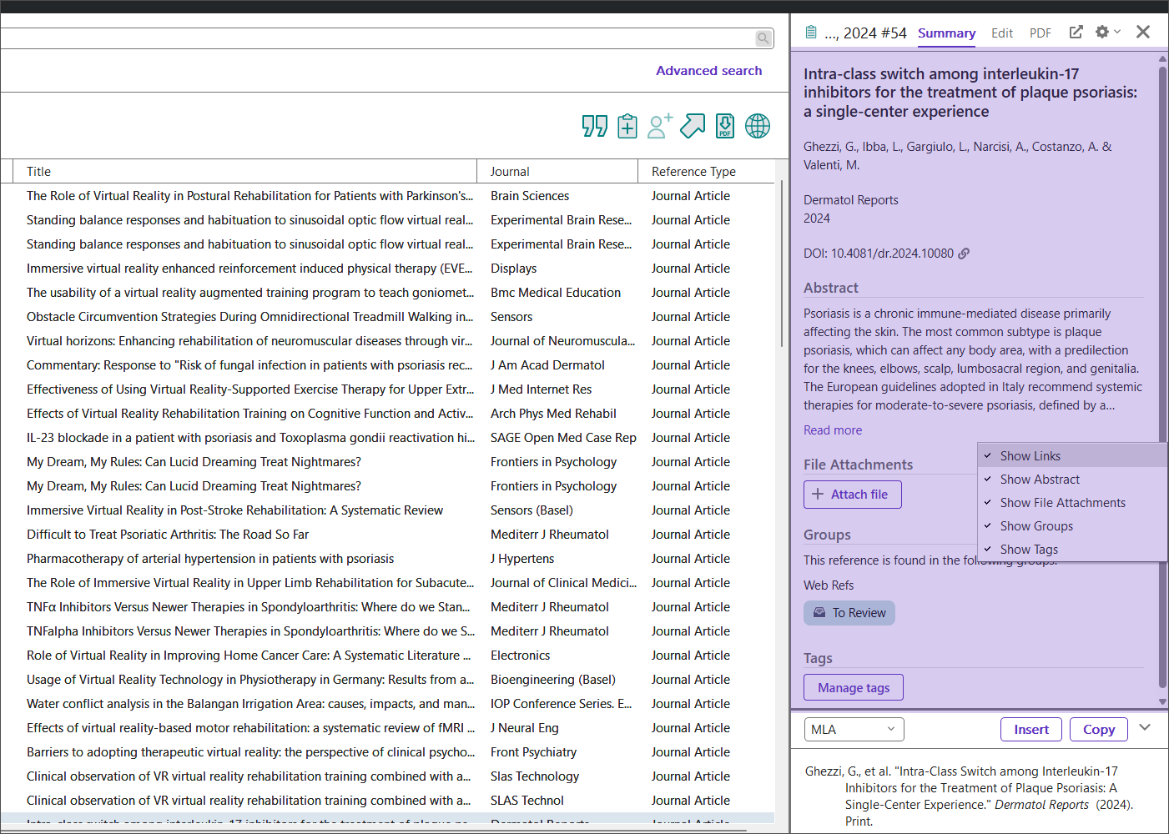
Summary Panel redesign
Advanced grouping and record updating
All your reference information—at a glance
Unified view: citation, notes, summary, preview
Fewer clicks to key details
Cleaner, visual layout

Slide 8
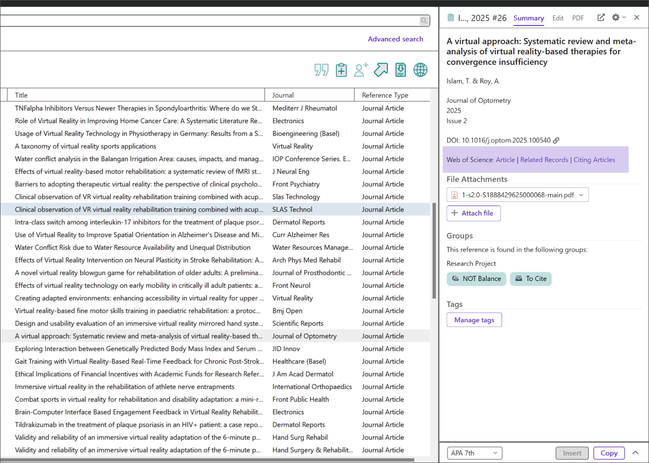
Web of Science Citing Articles
Advanced grouping and record updating
Deeper Research Context
Explore citing articles and related research
View directly from within EndNote
Subscription required

Slide 9
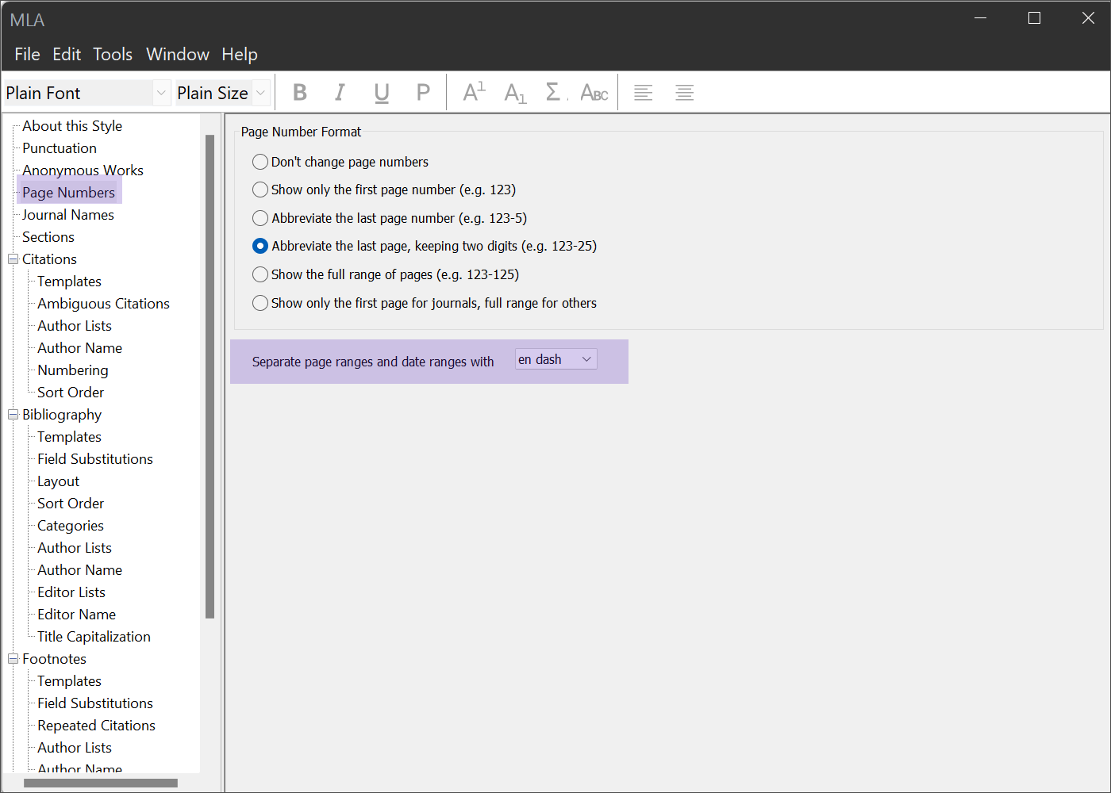
En Dash support
Advanced grouping and record updating
Style-Savvy Citations: Hyphen vs. En Dash
New dropdown in Output Style Editor
Choose between hyphen or en dash
Supports APA, Chicago, and others

Slide 10
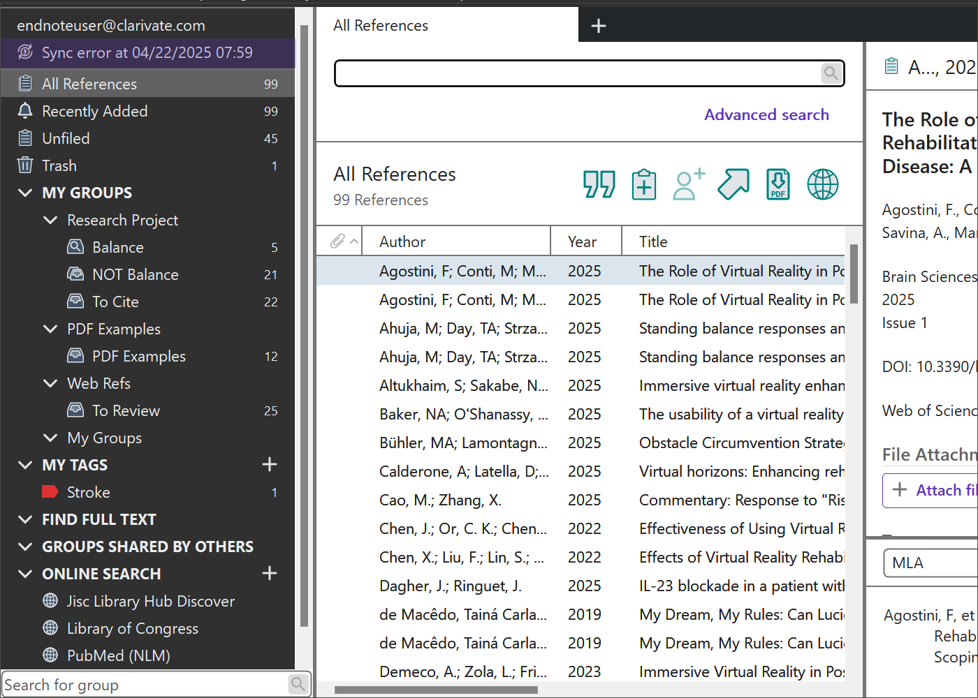
Enhanced Sync process visibility
Advanced grouping and record updating
Smarter Sync + Easier Collaboration
Real-time sync status indicators
Share with up to 1,000 users
Assign view/edit roles

Slide 11
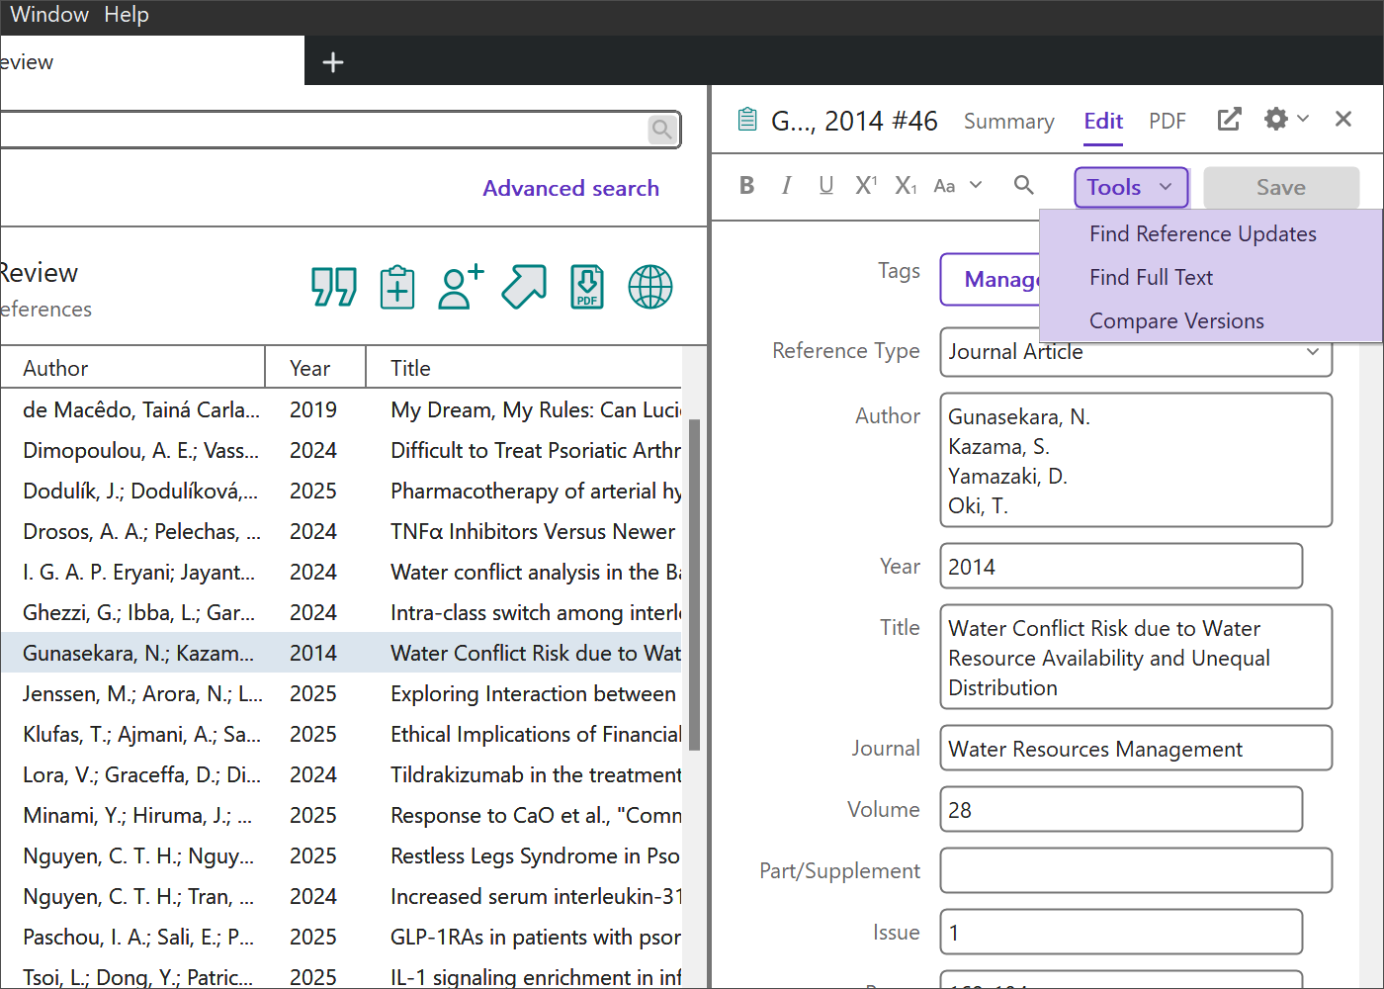
Edit tab and Library Status updates
Advanced grouping and record updating
Quick Edits. Clear Insights.
Cleaner Edit Tab layout
New Library Status window with stats
Easier to update multiple records

Slide 12
Demo

Slide 13
Final takeaways
Advanced grouping and record updating
AI + automation = faster research
Better formatting control
Built-in publishing tools
Smarter collaboration
Streamlined workflows for every researcher

Slide 14
Expand your EndNote skills—sign up for the next webinar
By the end of this webinar, you should be able to:
Create a new EndNote library and save it to an unsynced local folder
Understand the workflow for manual reference creation
Use an online database (such as PubMed) to export references

Slide 15
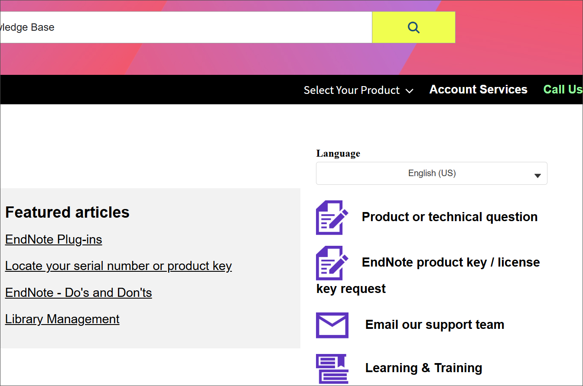
EndNote support hub: your go-to help resource
Get help when you need it most
Clarivate has a team of EndNote experts available around the clock via chat, email, or phone through the EndNote support hub to assist with your inquiries

Slide 16
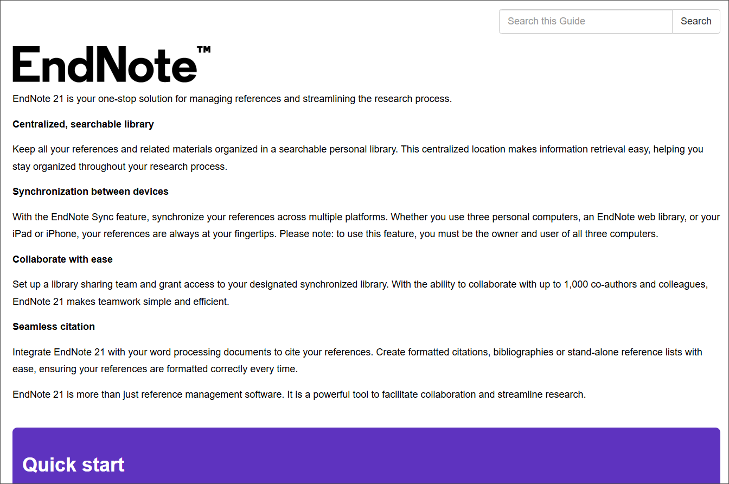
Your ultimate guide to EndNote
On-demand learning materials
Explore the EndNote LibGuide to access a wealth of resources, including eLearning modules, tutorial videos, a live training calendar, and quick reference guides—all designed to help you easily master EndNote

Slide 17
Think forward
training@proquest.com

